Slide 1
Changes in Single form Chapter 7.3
Only for NEW projects, and
since 11/2024: Health - WASH - Protection - Mine Action
since 11/2025: Shelter and settlements – Food security and livelihoods – Multi-purpose cash transfer (New KRIs)
Possibility of selecting several KRIs per subsector under one result.
Compulsory KRIs(*) and Standard KRIs
Priority = Standard KRIs, Custom indicator only if an essential project‘ aspect is not encompassed by the proposed KRIs

Slide 2

HOW TO PROCEED in case of a sector with several KRIs
Steps:
Select Result (as usual)
Select the Sector (as usual) and the relevant Sub Sector (as usual)
Select the ‘compulsory’ KRI (*)
Select all relevant ‘standard’ KRIs linked to the selected sub-sector
=> Within 1 sub-sector, DO NOT use KRIs from other (sub-)sectors
Repeat for each relevant sub-sector
Only if absolutely needed : create a ‘custom’ indicator

Slide 3
POTENTIAL ERROR & TIPS in case of a sector with several KRIs
Duplicated KRIs: The same KRI is encoded more than once
Selected KRIs are not in line with the chosen sub-sector or sector
=> KRIs need to be deleted
Compulsory KRIs are missing: compulsory KRIs(*) not selected => need to be added
! TIP To minimize errors, proceed subsector by subsector
(select all relevant KRIs per subsector at the same moment / don’t jump from one sub-sector to another one)
! TIP To minimize errors, do not use KRIs related to one sector for another sector
(select the relevant KRIs only related to the chosen subsector => do not mix KRIs linked to different sectors
! TIP Once chapter 7 completed, create the draft SF PDF and check for error
all errors linked to KRIs will be highlighted.
! TIP Correct error before the submission stage
The SF submission will be blocked until errors are corrected

Slide 4
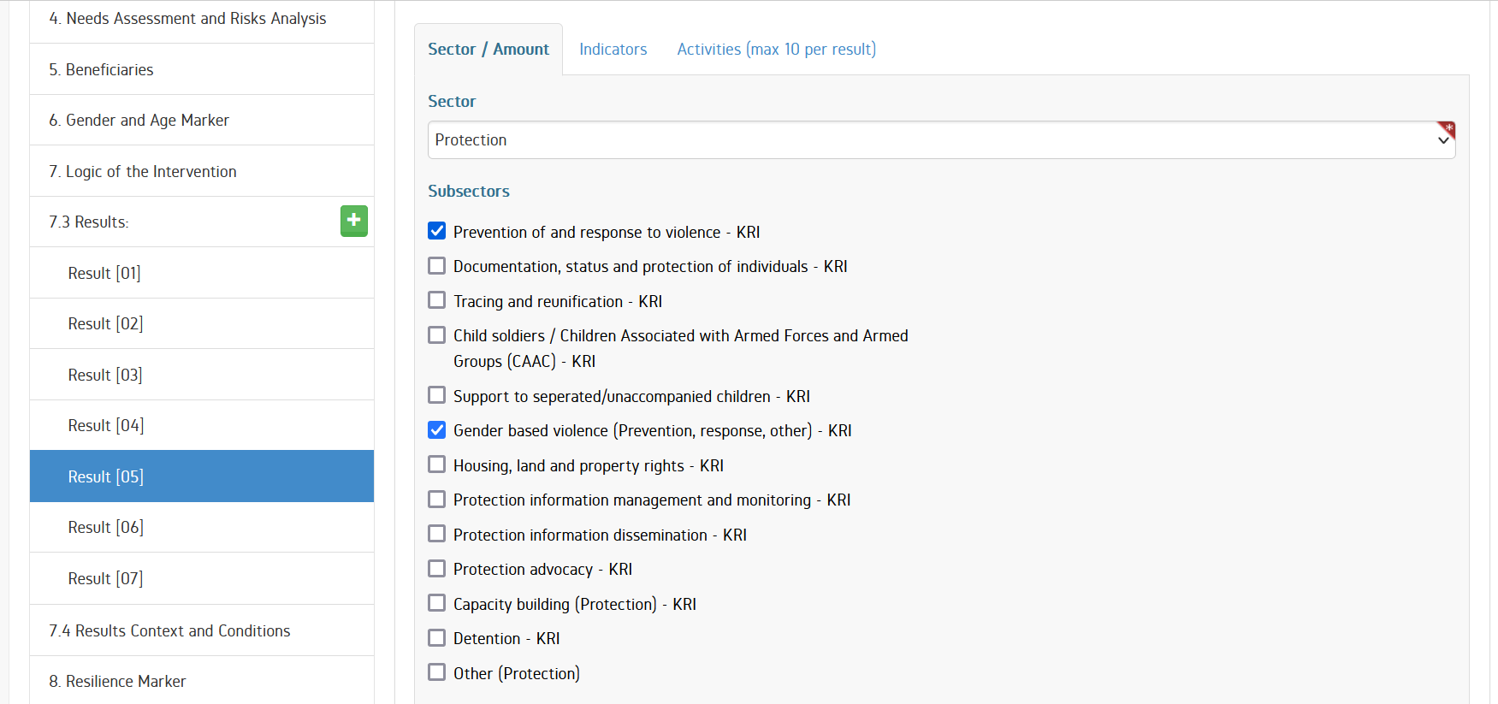
HOW TO DELETE A KRI in case of a sector with several KRIs (1/3)
1/ Select the relevant Result and click the Indicators tab

Slide 5
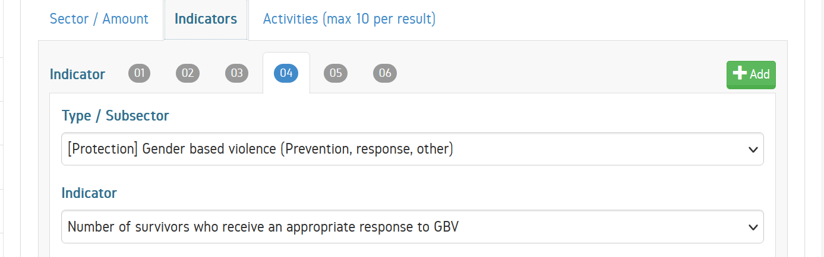
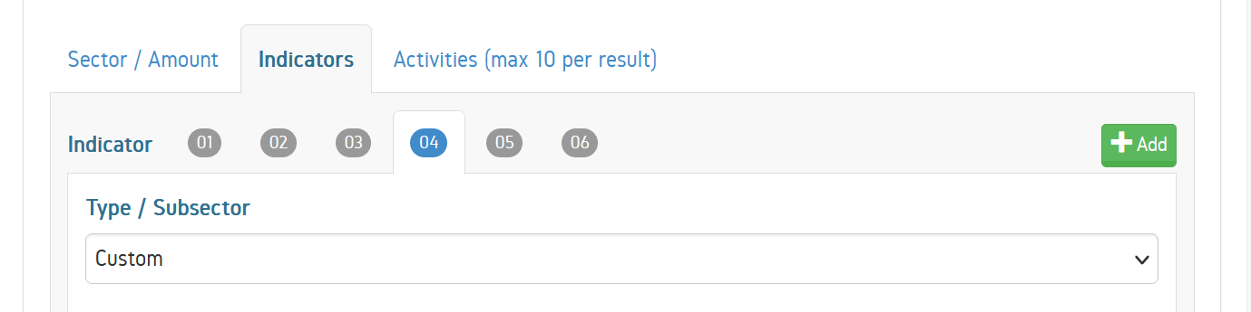
HOW TO DELETE A KRI in case of a sector with several KRIs (2/3)
2/ Under Indicators tab, select the Indicator number corresponding to the KRI to delete
duplicate KRI
3/ Select Custom in the drop-down list (! essential step)

Slide 6
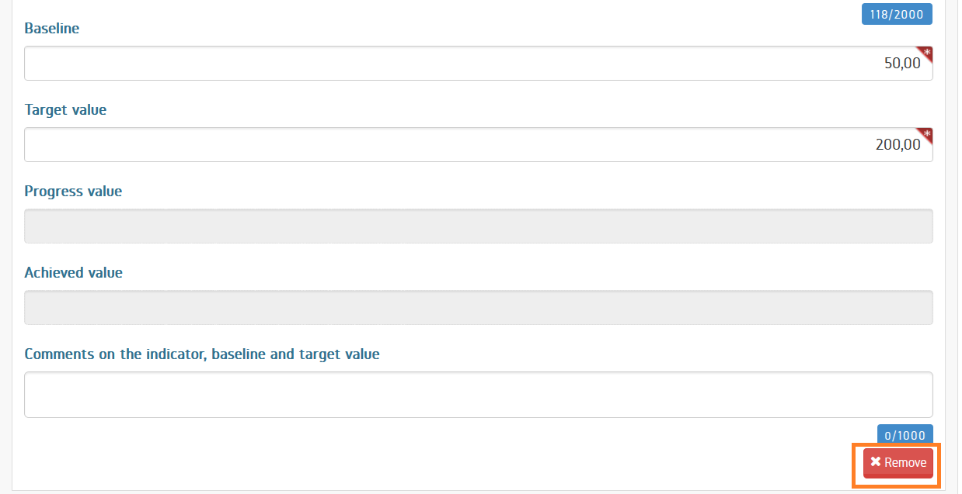
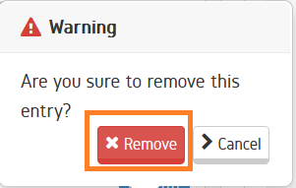
HOW TO DELETE A KRI in case of a sector with several KRIs (3/3)
4/ Go to the bottom of the screen and click on Remove. Confirm the Remove action

Slide 7
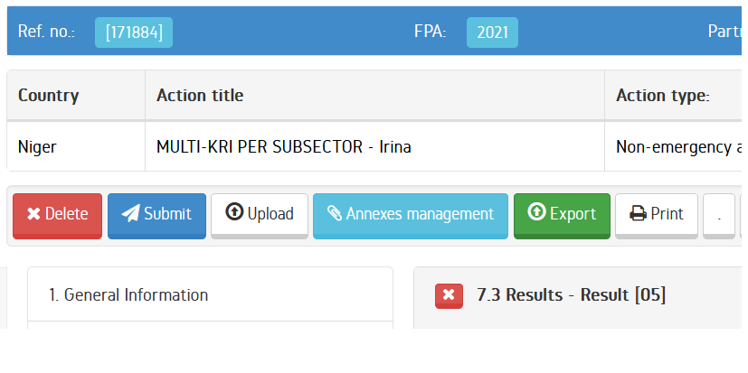
Several KRIs per sector – How to verify and/ or way to find back KRI that need to be deleted (1/2)
1/ Click on ‘print’ to create draft SF PDF

Slide 8
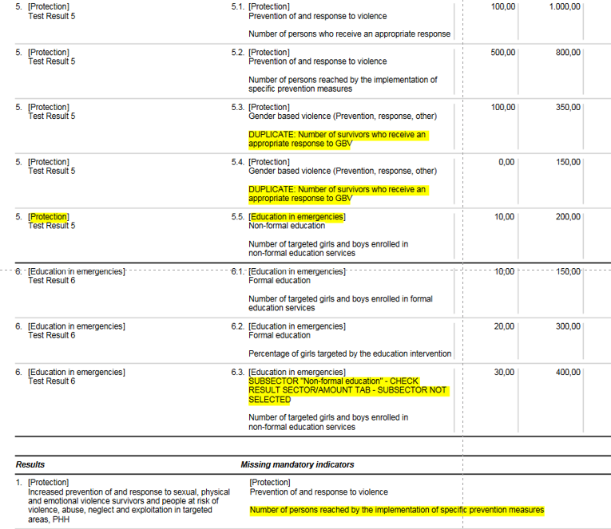
Several KRIs per sector – Verification / identification (2/2)
2/ On the Draft SF PDF, find error(s), note the KRIs’ number(s)
duplicate indicators
KRI linked to a subsector not in line with the selected sector
KRIS number
KRI linked to a subsector not selected
Missing Compulsory KRIs

